Slide 1
Committee Meeting
Cassidy Northway
PhD Candidate
March 30, 2026

Slide 2
Agenda
Review Thesis Question
Present Current Methodology: Determining Dose to Circulating Blood
Review Thesis Chapters: Seeking Committee Feedback
Graduation Timeline
Questions and Discussion

Slide 3
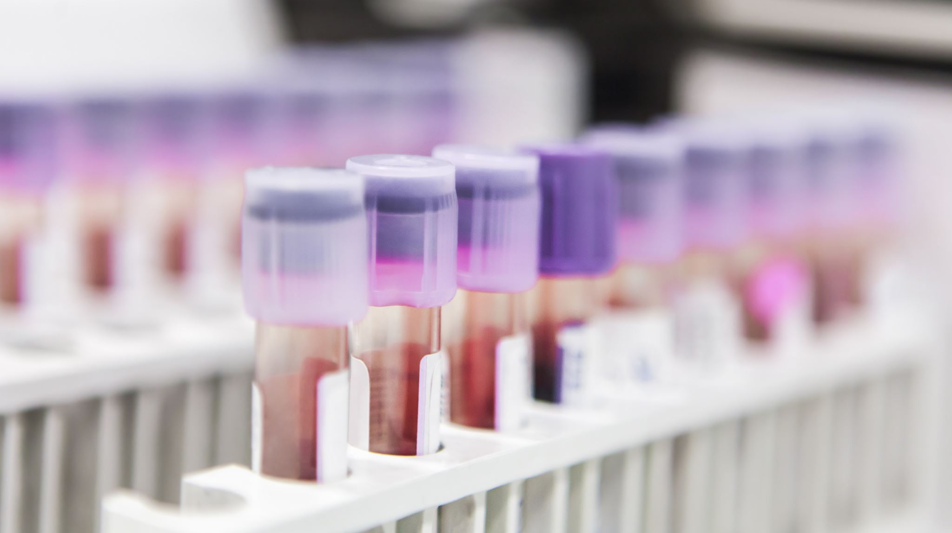
How heterogenous is the dose delivered to the circulating blood volume during TBI?

Slide 4
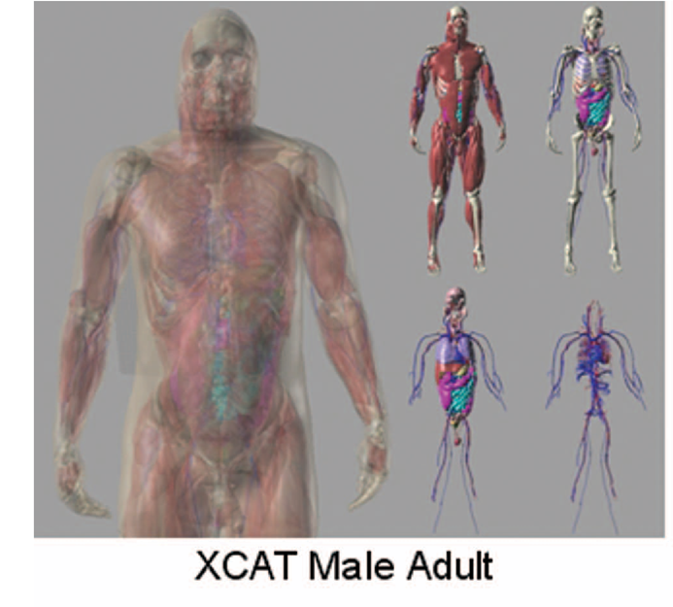
Thesis Proposal: Reviewed
In-silico, track the flow of blood voxels through a whole-body phantom undergoing TBI, calculate their cumulative dose, and compare the dose to the voxels.
Whole Body Phantom (4D XCAT) model unites a blood flow model and Monte Carlo (MC) Simulations to determine dose.
Model the following delivery methods in MC:
Sweeping Co-60
VMAT TBI
BCC – Vancouver Technique (POP + VMAT)
Variations (VMAT only, varying optimization goals)
Notes:
Segars, William Paul, Jason Bond, John P. Frush, Sylvia Hon, Christopher P. Eckersley, Cameron H. Williams, Jianqiao Feng, Daniel Jacob Tward, J. Tilak Ratnanather, M. I. Miller, Donald P. Frush and Ehsan Samei. “Population of anatomically variable 4D XCAT adult phantoms for imaging research and optimization.” Medical physics 40 4 (2013): 043701 .

Slide 5
What is the heterogeneity of dose to the circulating blood volume during TBI?
Presented at COMP 2025
Determine dose deposition in time
Track blood flow through the body
Model various TBI treatments

Slide 6
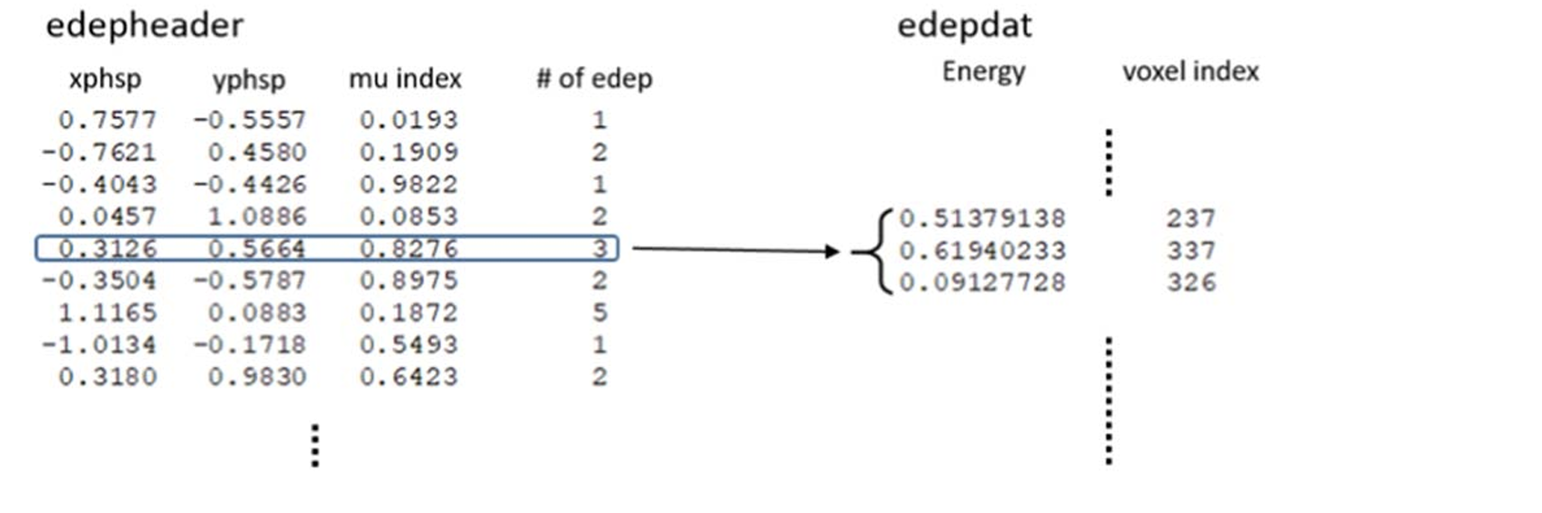
4ddose Outputs

Slide 7
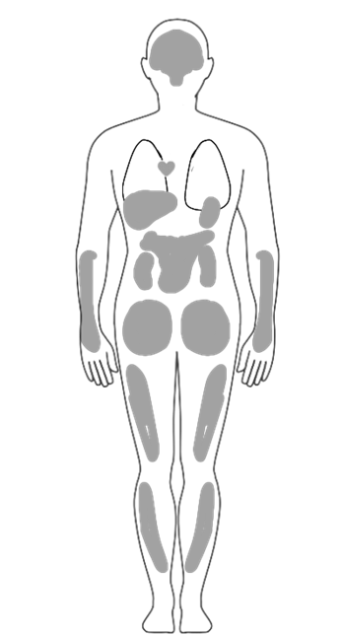
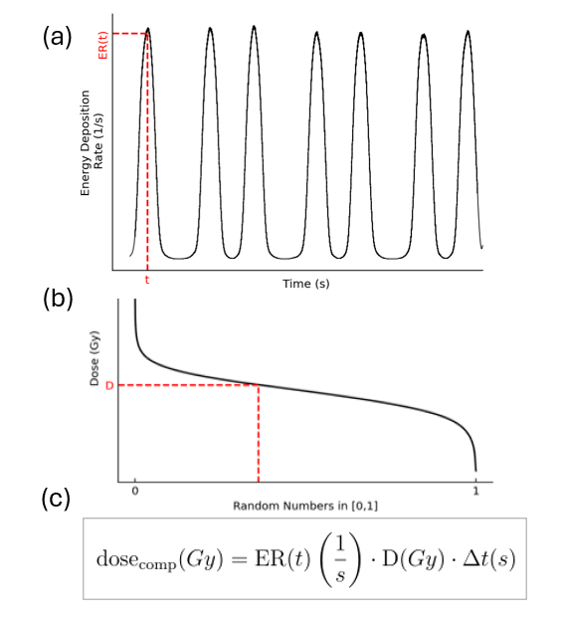
How is dose sampled in the 0D compartments?
dst (s)

Slide 8
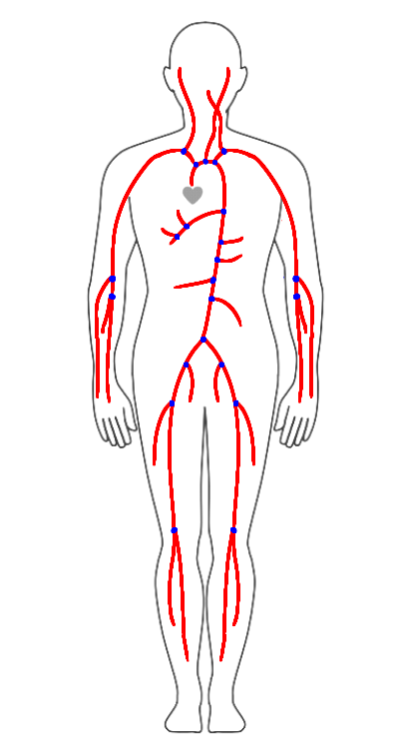
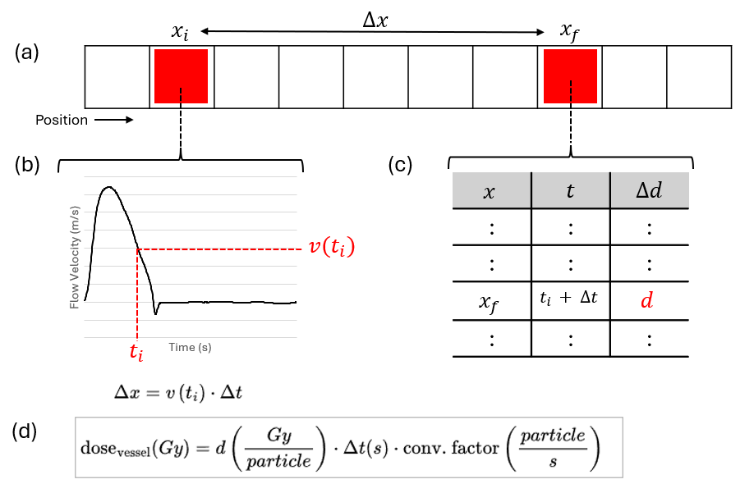
How is dose sampled in the blood vessels?
dst
dst (s)

Slide 9
Experimental Set-Up: Minimizing Uncertainty
Three sources of uncertainty:
4D Dose Simulations
Number of particles simulated (Stochastic)
↑ the number of particles simulated = ↓ stochastic uncertainty = ↑ simulation time
Solution: Run each sweep of the Co-60 head as its own simulation with 2E11 particles. Each sweep takes ~20 hrs to calculate

Slide 10
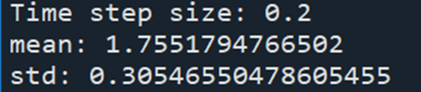

Experimental Set-Up: Minimizing Uncertainty
Three sources of uncertainty:
4D Dose Simulations
Number of particles simulated (Stochastic)
↑ the number of particles simulated = ↓ stochastic uncertainty = ↑ simulation time
Solution: Run each sweep of the Co-60 head as its own simulation with 2E11 particles. Each sweep takes ~20 hrs to calculate
Size of time bin used to sample dose data
↑ time bin size = ↓ time resolution = ↑ positional averaging & ↑ particle number / dose uncertainty
Solution: Determine the significance of dst on mean and std of dose (Currently running)

Slide 11
Experimental Set-Up: Minimizing Uncertainty
Three sources of uncertainty:
4D Dose Simulations
Number of particles simulated (Stochastic)
↑ the number of particles simulated = ↓ stochastic uncertainty = ↑ simulation time
Solution: Run each sweep of the Co-60 head as its own simulation with 2E11 particles. Each sweep takes ~20 hrs to calculate
Size of time bin used to sample dose data
↑ time bin size = ↓ time resolution = ↑ positional averaging & ↑ particle number / dose uncertainty
Solution: Determine the significance of dst on mean and std of dose
Number of BVs Simulated (Stochastic)
↑ the number of particles simulated = ↓ stochastic uncertainty = ↑ simulation time
Solution: Characterize the mean and std of the dose to the BVs as a function of BV number

Slide 12
Thesis Chapter Outline

Slide 13
Introduction to thesis
Provide context for research and summarize the content of the thesis

Slide 14
Introduction to thesis
Provide context for research and summarize the content of the thesis
Introduction to Radiation Therapy
Principles of RT
Treatment Devices (Co-60 and Linac)

Slide 15
Introduction to thesis
Provide context for research and summarize the content of the thesis
Introduction to Radiation Therapy
Principles of RT
Treatment Devices (Co-60 and Linac)
Introduction to Total Body Irradiation
Hematological malignancies
History of TBI
Modern TBI

Slide 16
Introduction to thesis
Provide context for research and summarize the content of the thesis
Introduction to Radiation Therapy
Principles of RT
Treatment Devices (Co-60 and Linac)
Introduction to Total Body Irradiation
Hematological malignancies
History of TBI
Modern TBI
Developing a Whole-Body Blood Flow Model for Dosimetric Applications
Intro to Blood Flow Modelling
Methodology, Results, Discussion

Slide 17
Introduction to thesis
Provide context for research and summarize the content of the thesis
Introduction to Radiation Therapy
Principles of RT
Treatment Devices (Co-60 and Linac)
Introduction to Total Body Irradiation
Hematological malignancies
History of TBI
Modern TBI
Developing a Whole-Body Blood Flow Model for Dosimetric Applications
Intro to Blood Flow Modelling
Methodology, Results, Discussion
Determining Dose to the Circulating Blood
Intro to Monte Carlo, EGSnrc and 4ddose
Methodology, Results, Discussion

Slide 18
Introduction to thesis
Provide context for research and summarize the content of the thesis
Introduction to Radiation Therapy
Principles of RT
Treatment Devices (Co-60 and Linac)
Introduction to Total Body Irradiation
Hematological malignancies
History of TBI
Modern TBI
Developing a Whole-Body Blood Flow Model for Dosimetric Applications
Intro to Blood Flow Modelling
Methodology, Results, Discussion
Determining Dose to the Circulating Blood
Intro to Monte Carlo, EGSnrc and 4ddose
Methodology, Results, Discussion
Comparing Dose to Blood Achieved by Various TBI Delivery Methods
Methods, Results, Discussion

Slide 19
Introduction to thesis
Provide context for research and summarize the content of the thesis
Introduction to Radiation Therapy
Principles of RT
Treatment Devices (Co-60 and Linac)
Introduction to Total Body Irradiation
Hematological malignancies
History of TBI
Modern TBI
Developing a Whole-Body Blood Flow Model for Dosimetric Applications
Intro to Blood Flow Modelling
Methodology, Results, Discussion
Determining Dose to the Circulating Blood
Intro to Monte Carlo, EGSnrc and 4ddose
Methodology, Results, Discussion
Comparing Dose to Blood Achieved by Various TBI Delivery Methods
Methods, Results, Discussion
Future Work and Conclusion

Slide 20
Timeline Update

Slide 21
Timeline
Began September 2020 -> Deadline would be August 2026
Request an extension to this deadline (2 term)

Slide 22
Thank you.

Slide 23
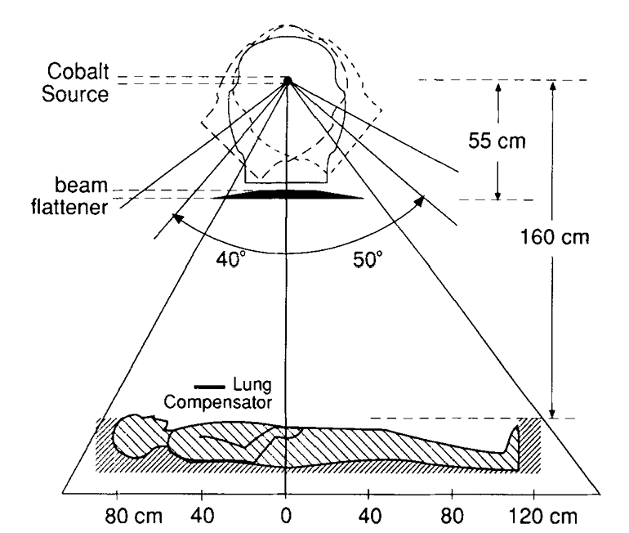
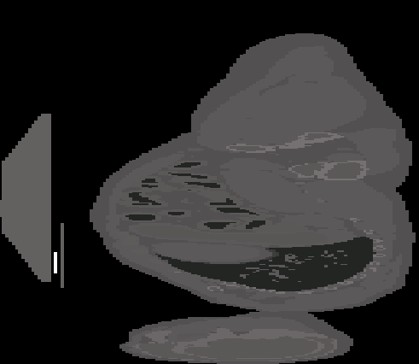
Sweeping Co-60
S. Hussein and E. el-Khatib, “Total body irradiation with a sweeping 60Cobalt beam,” Int J Radiat Oncol Biol Phys, vol. 33, no. 2, pp. 493–497, Sept. 1995, doi: 10.1016/0360-3016(95)00164-T.

Slide 24
What is the heterogeneity of dose to the circulating blood volume during TBI?
Presented at COMP 2025
Determine dose deposition in time
Track blood flow through the body
Model various TBI treatments

Slide 25
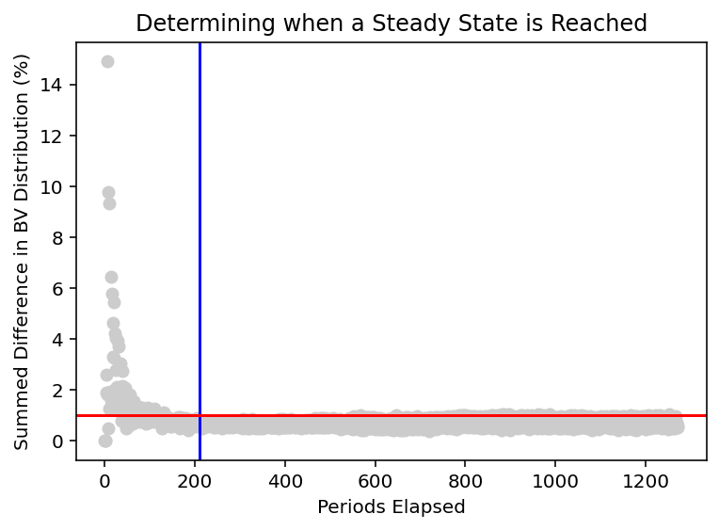
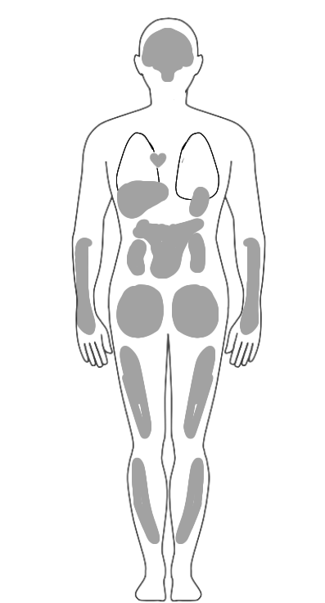
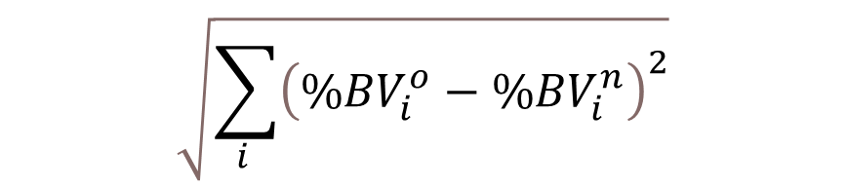
Steady State Identification
All Blood Voxels Released
1%
$$\sqrt{\sum_{i }{{\left({\%BV}_{i}^{o}−{\%BV}_{i}^{n}\right)}^{2}}}$$

Slide 26
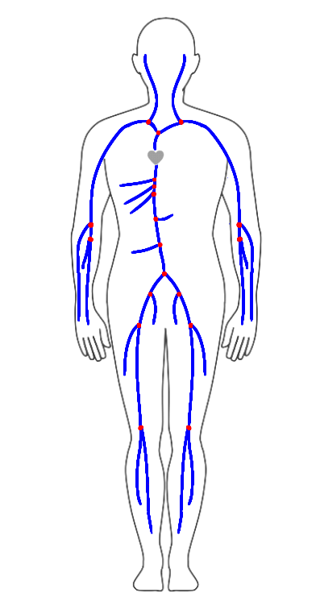

Model Components – Systemic Veins
Doppler ultrasound and MRI flowrate data
$$Q\left(0\right)= {Q(L)}_{a}+{Q(L)}_{b}$$
Notes:
1D modelling, what is it, how are vessels connected to each other, how does bv move down the vessels starting at the heart.

Slide 27
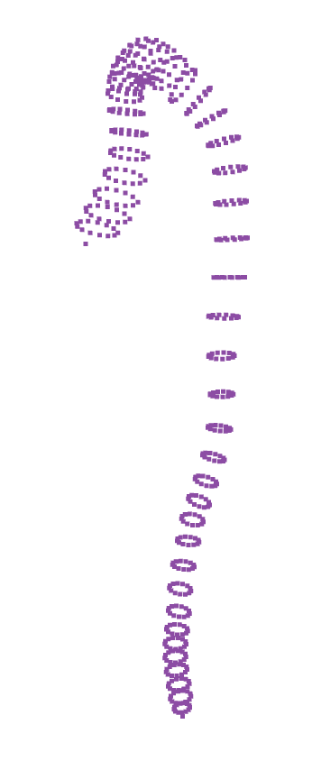
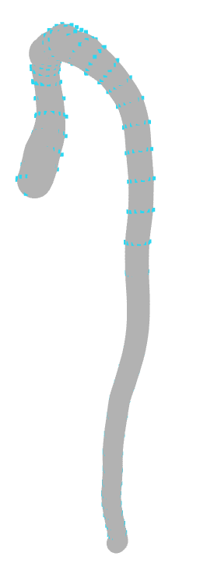
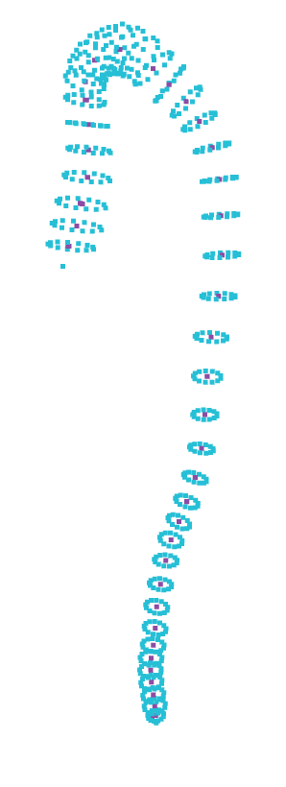
Dimension Extraction
Superior Mesenteric Artery
Calculated length (N =12)
$\overline{L}=220.84 mm ±0.33 \%$
Manually measured length
$L=212.75$ mm
Hemolab Value:
$L=216.79$ mm
Calculated radius (N = 12)
$R_{u}=1.79 mm ±2.79 \%$
$R_{d}=1.66 mm±18.67 \%$
Jin, Young-Hoon, and Won-Hyung Lee. “Fast cylinder shape matching using random sample consensus in large Scale Point Cloud.” Applied Sciences, 9, 5, 2019.
Watanabe, Sansuke M., Blanco, Pablo J., and Feijóo, Raúl A.. "Mathematical Model of Blood Flow in an Anatomically Detailed Arterial Network of the Arm." ESAIM: Mathematical Modelling and Numerical Analysis - Modélisation Mathématique et Analyse Numérique 47, 4, 2013.

Slide 28
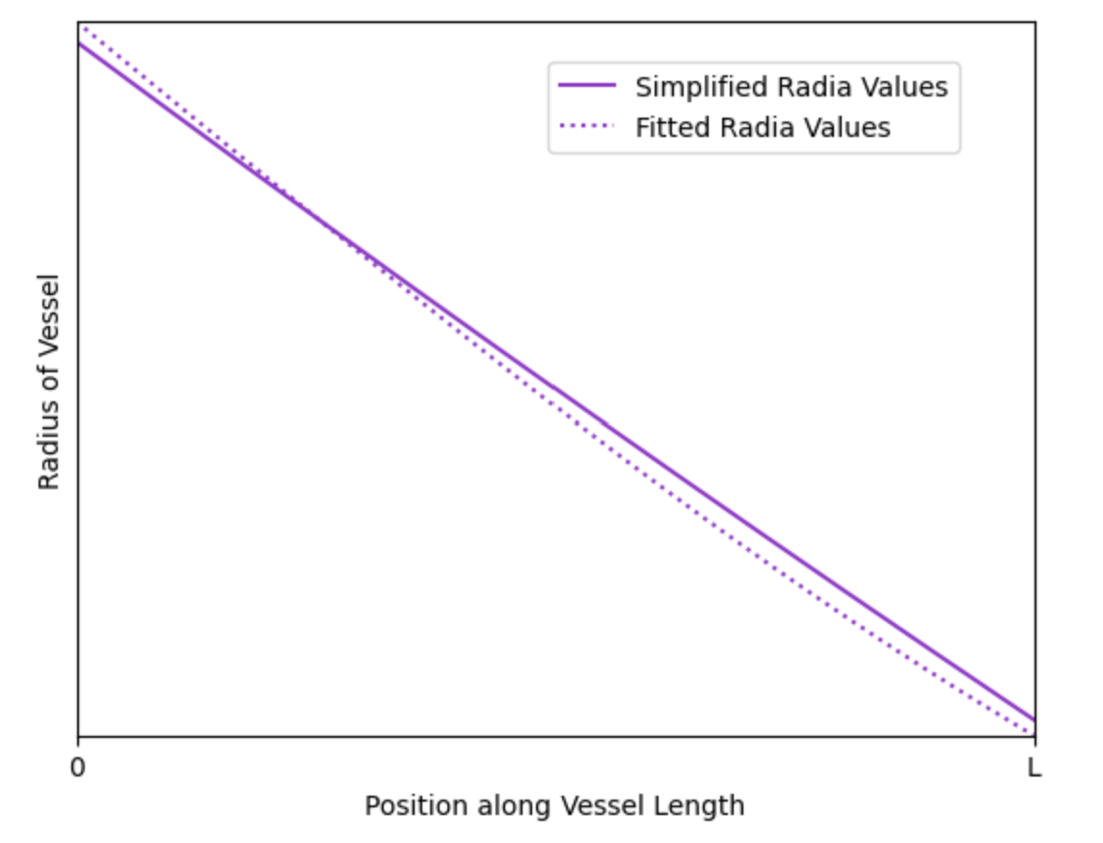
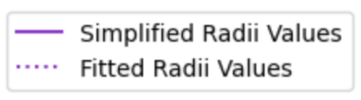
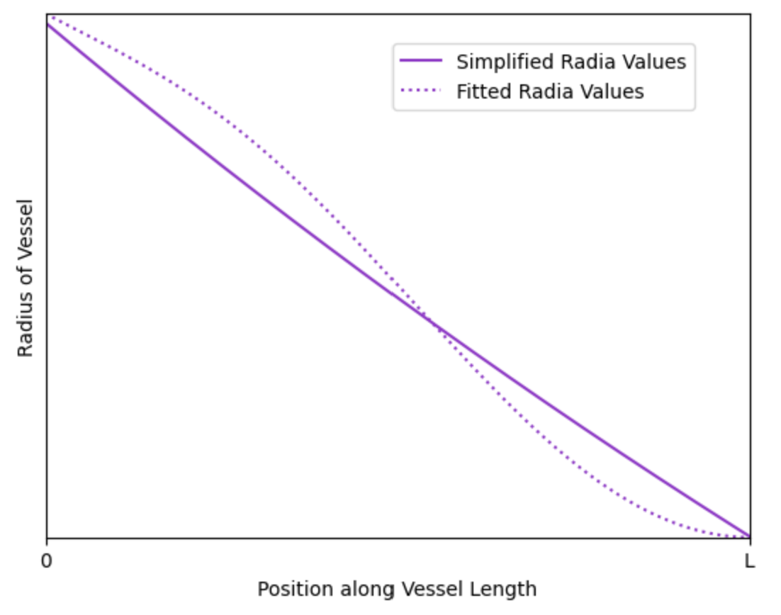
Network and Simplifications
$$R \left(x\right)=R_{u} {\frac{R_{d}}{R_{u}}}^{\frac{x}{L}}$$
Olufsen, Mette Sofie. “Structured tree outflow condition for blood flow in larger systemic arteries.” American journal of physiology. Heart and circulatory physiology , 276, 1, 1999.

